Slide 1
The Flipped Classroom, Part II
Brooke Morin
The Ohio State University

Slide 2
Outline
Why did we implement the flipped classroom?
What structure did the new class take?
How did the students perform under the new format?
How did the students respond to the new format?
What can be improved moving forward?

Slide 3
Why the flipped classroom?
Better use of resources
  Time
  Instructional staff
Life-long learning skills
Fewer expectations in the first year

Slide 4
Fundamentals of Engineering for Honors
~550 students this fall
15 sections of 36 students each
Course meets 4 times per week for 125 minutes
  3 class periods
  1 lab period
First semester focuses on problem solving

Slide 5
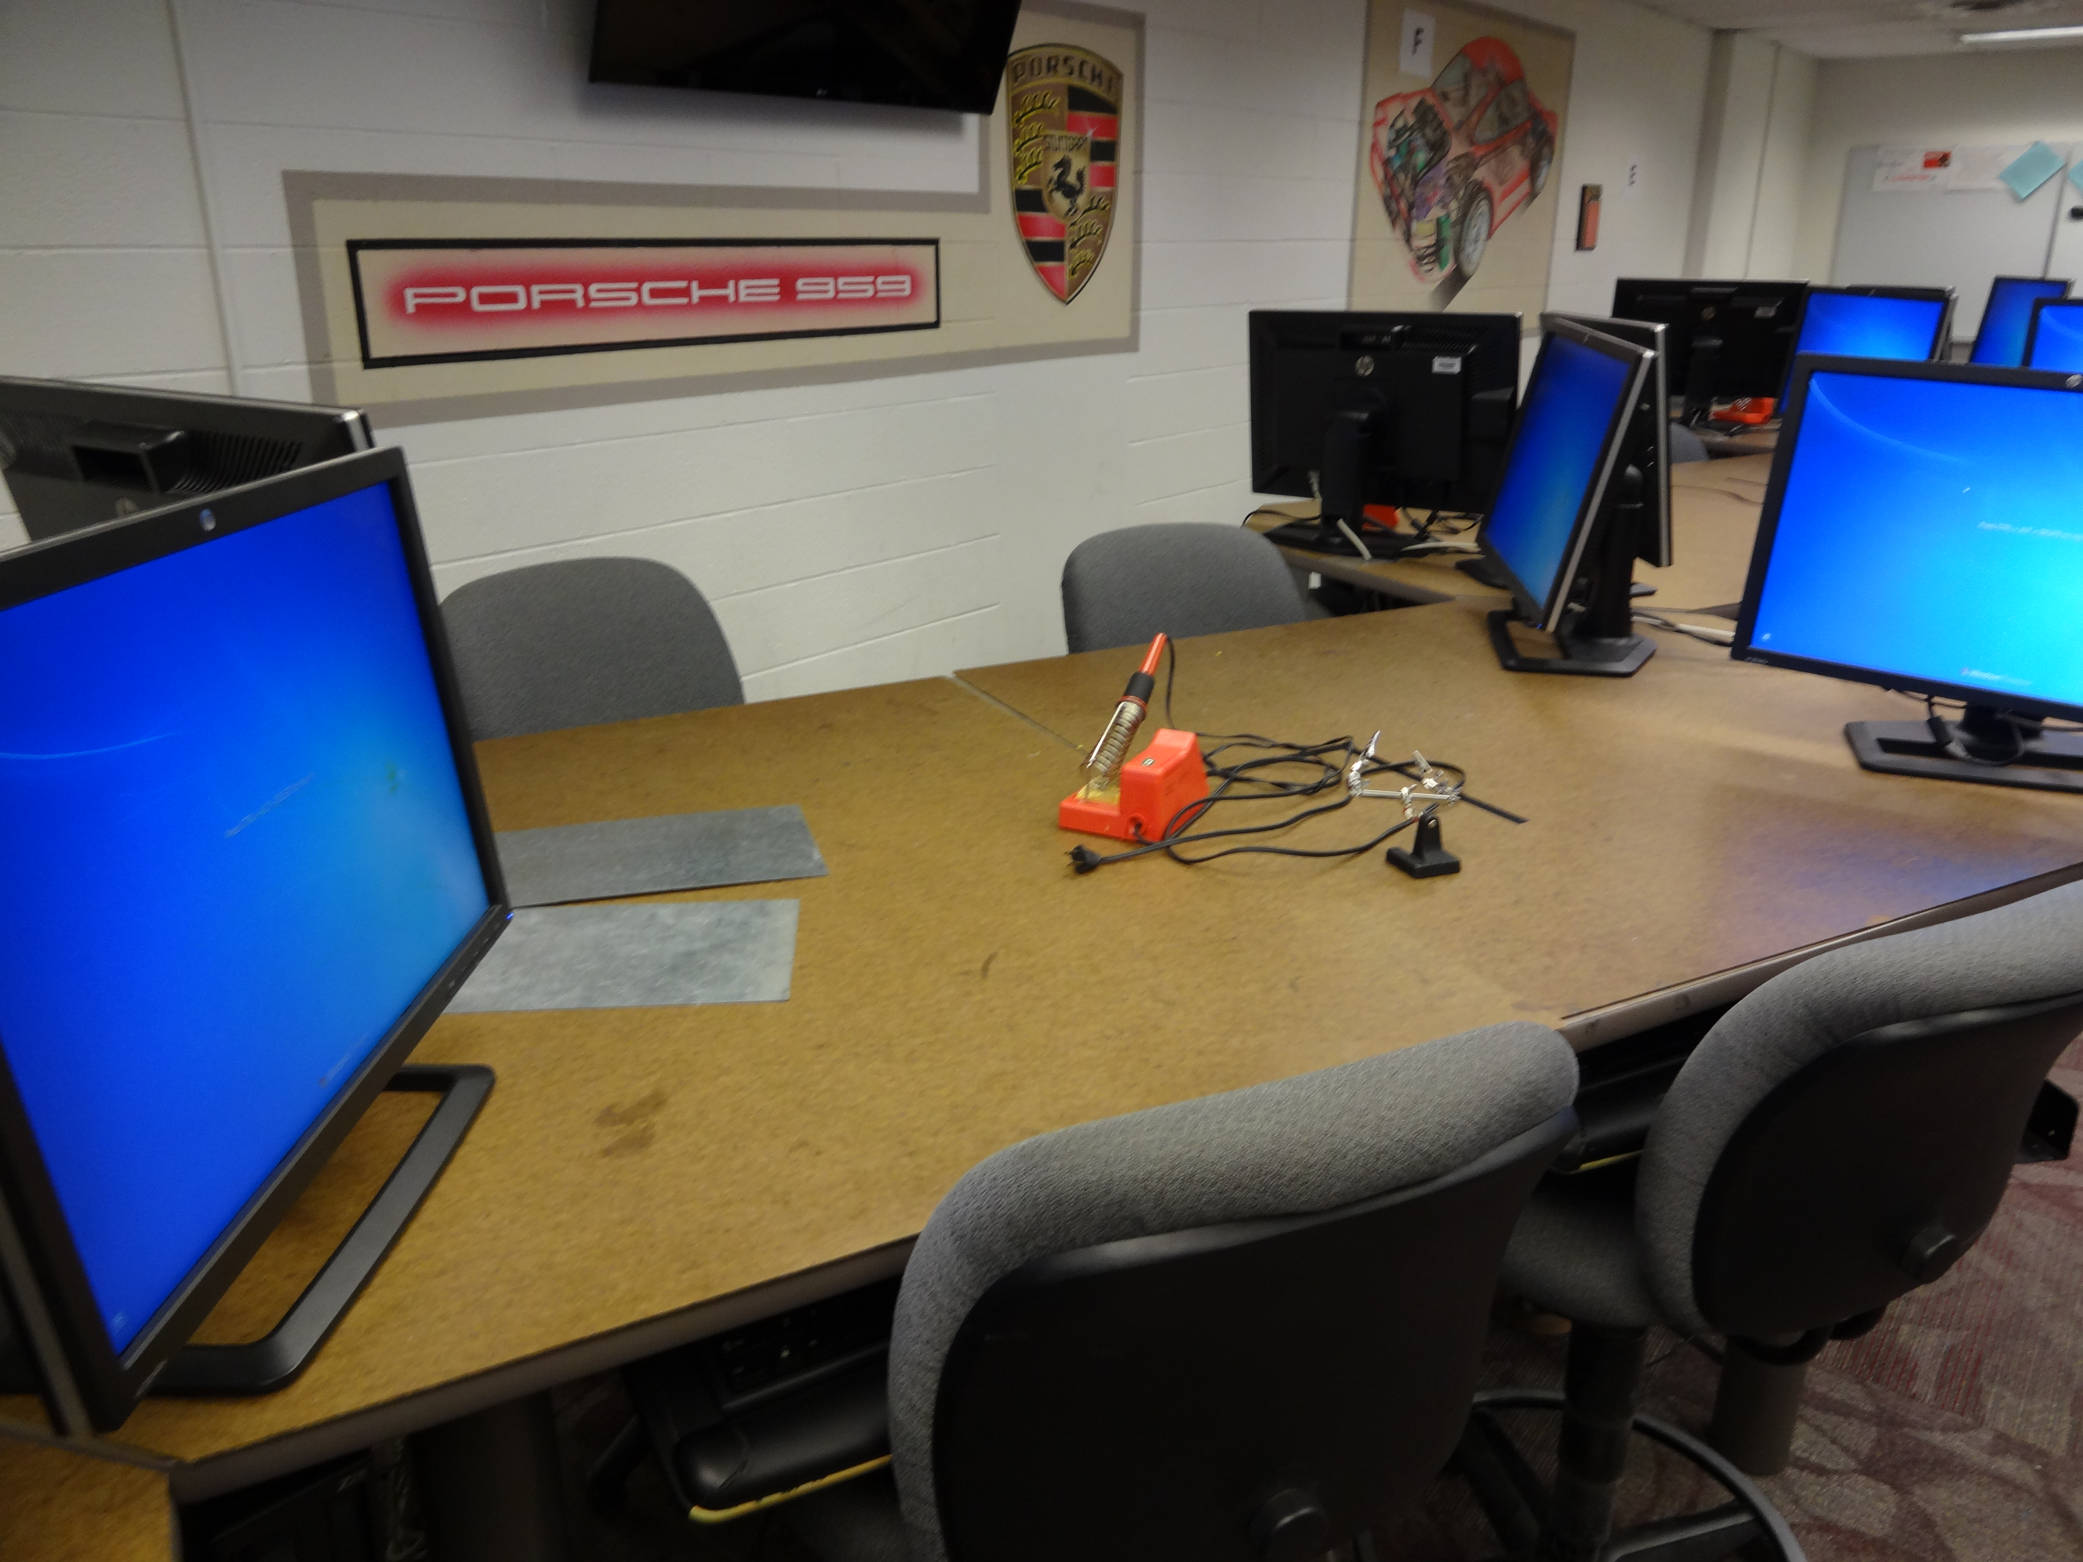
The classroom

Slide 6
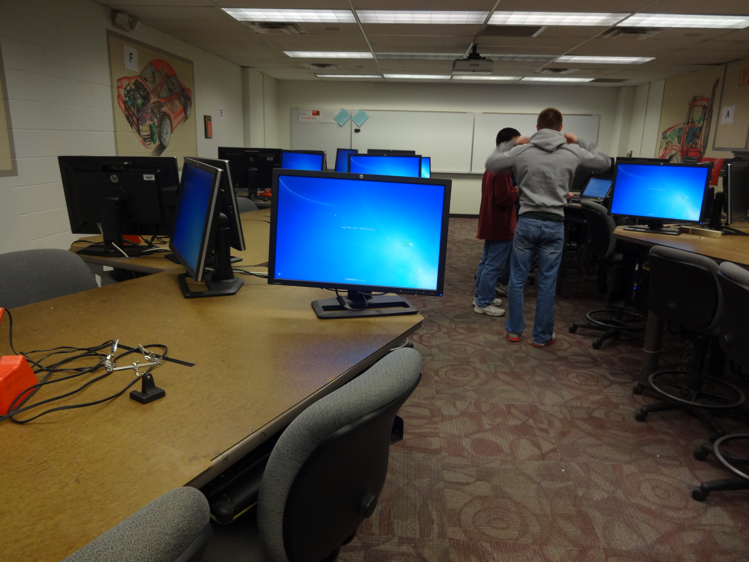
The classroom

Slide 7
The flipped format
Before Class | During Class | After Class
Preparation activity Evaluation | Short lecture Activities Application assignment(s) | Finish application assignment(s) Prepare for next class

Slide 8
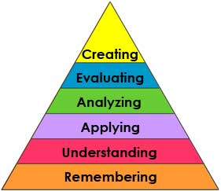
Preparation Activities
Videos
Reading
Quizzes
Exercises
Tutorials
www.odu.edu

Slide 9

Videos

Slide 10
Sample Quiz Questions
Questions | Answer Choices
Select all commands that will properly get a character from the keyboard (stdin), where the variable declaration is: char ch; | ch = getchar();
 | ch = getc();
 | getchar(ch);
 | ch = getc(stdin);
Which of these commands can be used for writing a character to a file where the variable declarations are: char ch; FILE *fileoutptr; | putchar(ch, fileoutptr);
 | putc(fileoutptr, ch);
 | putchar(fileoutptr, ch);
 | putc(ch, fileoutptr);
In C/C++, which of the following format specifiers is used for float variables? | %d
 | %i
 | %c
 | %f

Slide 11
Application Activities
Activities
Problems
www.odu.edu

Slide 12
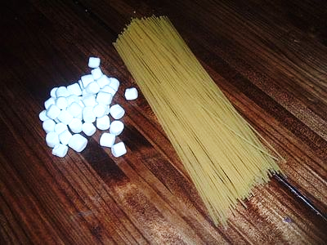
Activities: Spaghetti & Marshmallows
Engineering Design Process
DEFINE
PROBLEM
CREATE SPEC./REQ.
CREATE DESIGN CONCEPTS
DESIGN SOLUTION
CREATE PROTOTYPE
TEST/VALIDATE DESIGN
DEVELOP SPEC/REQ
DEVELOP DESIGN
www.ehow.com

Slide 13
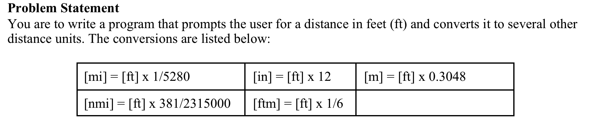
Problems

Slide 14
Evaluating the changes
Student performance on exams
  N=237
Relationship between preparation and other course metrics
  N=473
Student preferences for preparation activities
  N=150

Slide 15
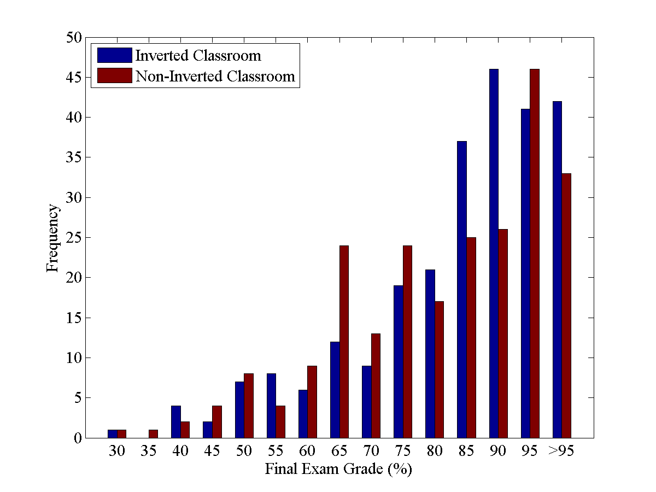
Final Exam Performance

Slide 16
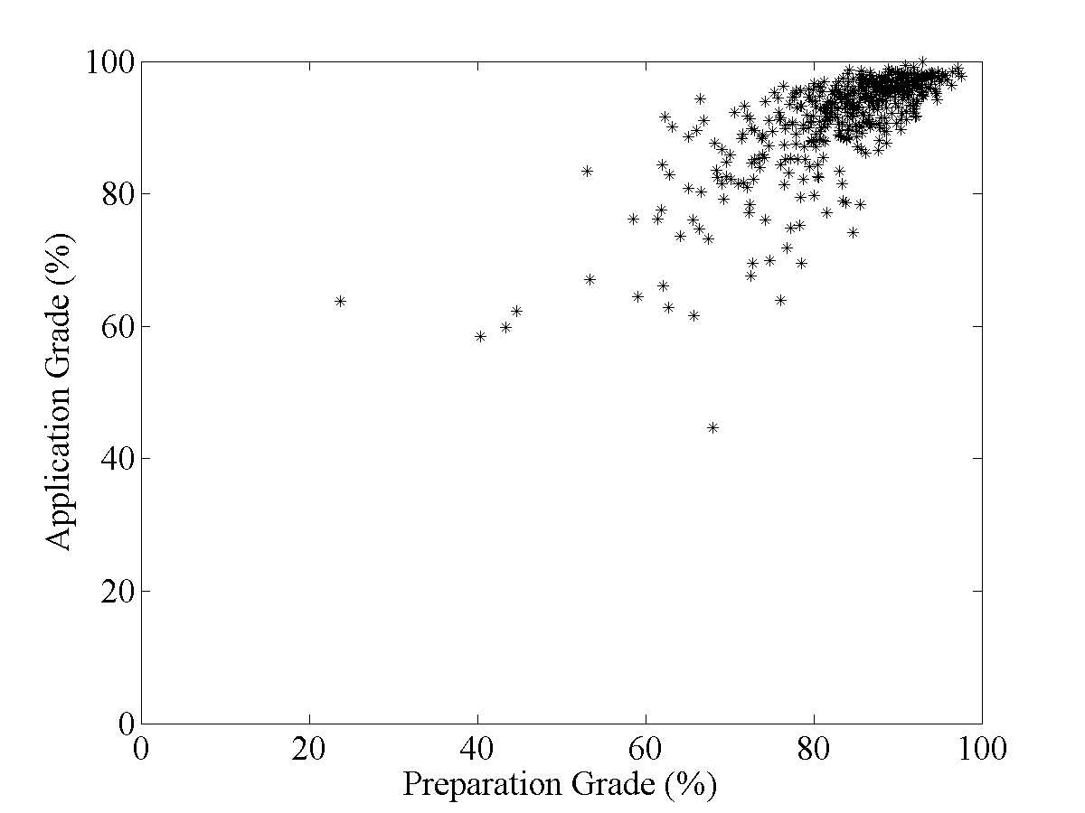
Preparation and Application
r=0.742
p<0.01

Slide 17
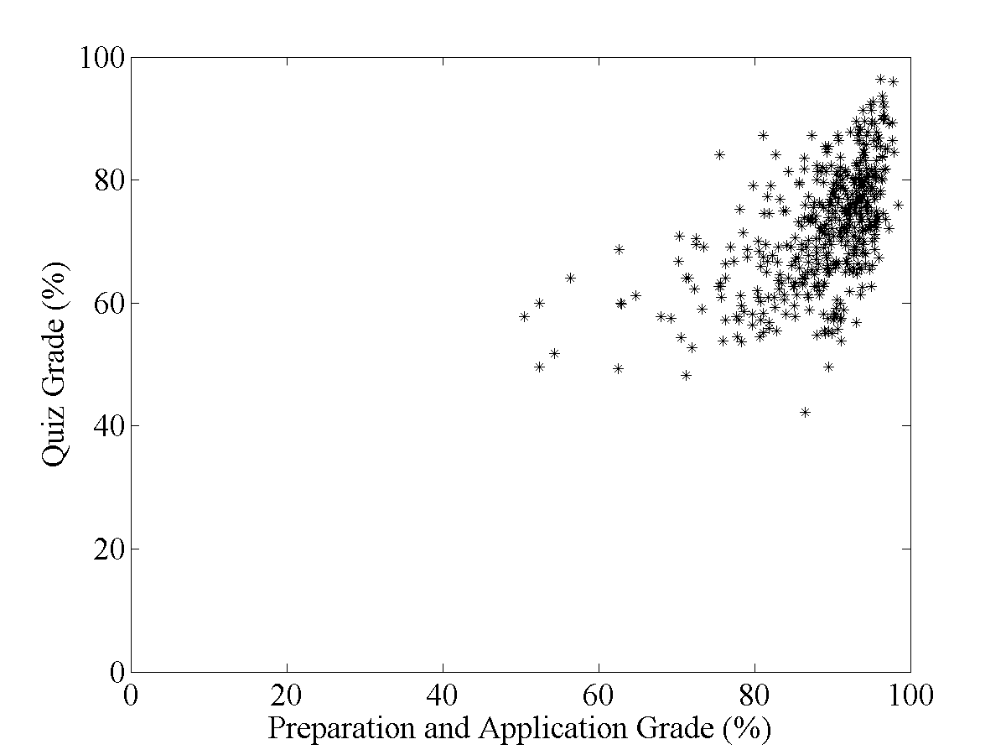
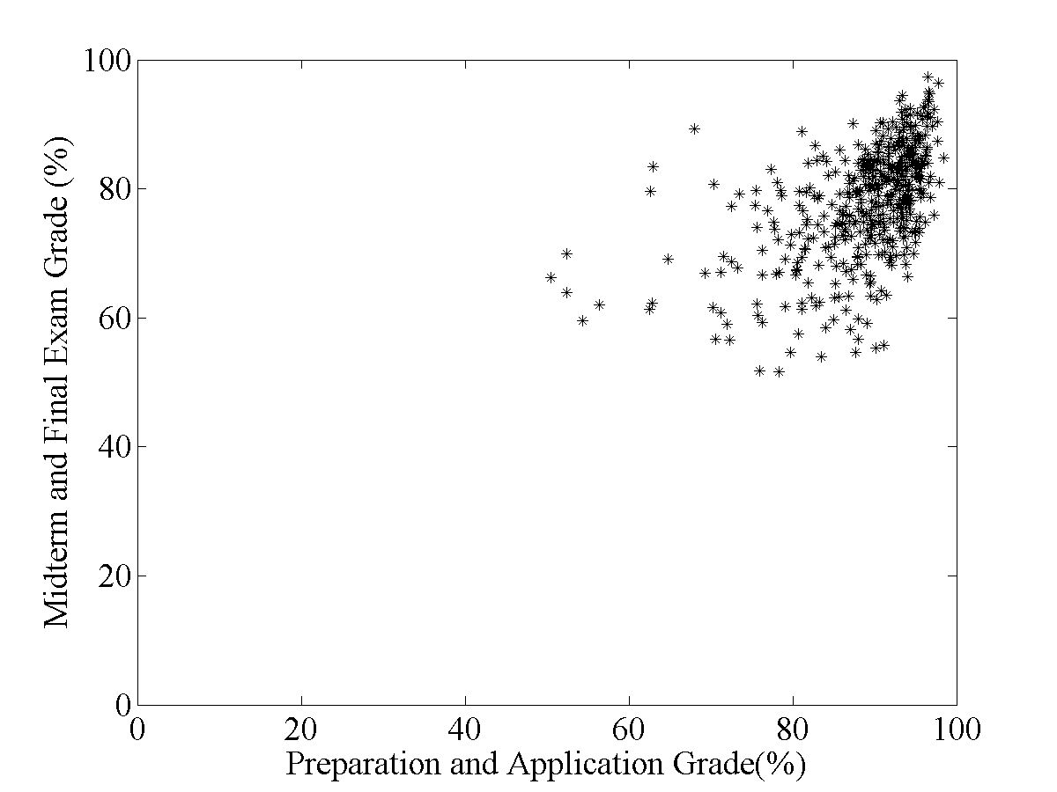
r=0.556
p<0.01
r=0.521
p<0.01

Slide 18
Student Feedback
Online anonymous journal system
“During this term, you have been given a variety of assignments to do in preparation for upcoming classes: reading, watching videos, completing tutorials, working problems, taking quizzes. Which of these styles have been the most helpful to you and why? Which have not been as helpful and why? Do certain types of preparation work fit better with particular topics? If so, please give some examples of particularly good or bad ‘fits.’”

Slide 19
Preferred preparation activities

Slide 20
Surprise: Quizzes scored the best
“Doing the quizzes before class have been the best for me because it forces me to look at the book and get ready for the class. I feel that the quizzes work the best in all areas.”
“…I found the quizzes to be most helpful. I thought they did a good job of narrowing in on the topic that would be covered.”

Slide 21
Quizzes
Students liked…
  A narrowed focus on important material
  A source of accountability
Students disliked…
  Being “tested on something you have barely been taught”
  Convenience of merely looking up answers

Slide 22
Reading and videos
“The most helpful for me was reading the book before class…the videos were not helpful to me, and I honestly quit watching them after about three weeks,”
“Reading is always least preferred, but that’s just how it is because it makes me fall asleep… Videos of programming and how to make sample code has [sic] been very helpful.”

Slide 23
Reading
Students liked…
  Quickly finding answers in the text
  Moving at their own pace
Students disliked…
  Quantity of material
  Irrelevant reading sections
  Quality of the book

Slide 24
Videos
Students liked…
  Clear descriptions of the material
  Focus on “visual” learning
Students disliked…
  Length
  Redundancy/pace

Slide 25
Problems and tutorials
Relatively few mentions
“All the completing tutorials and working problems pre-assignments have been the most helpful styles to me because it made me actually want to do the pre-assignments and gave me material to look back on later that I could actually use as guidance and a helpful tool.”

Slide 26
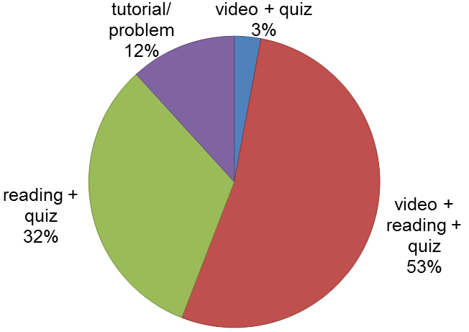
Possible correlation

Slide 27
Well-accepted
Only 1.3% of students found none of the preparation work helpful
“there is just so much work”
“it was really easy… so they were useless”

Slide 28
What we learned
Attitude is critical!
  Must be firm
  Act as though it’s always been this way
It is easy for the inverted classroom to overload the students.
  Preparation + application is a lot!
  Complete application in class
  Quantity of preparation assignments

Slide 29
What we learned
Video length and format are important
  Under 15 minutes
  Introduction and outline presented elsewhere
  Watch redundancy
Reading needs to be relevant
  Do not let preparation work seem useless

Slide 30
What we learned
Students need to feel accountable
  Evaluating preparation is key
  Watch grading load
  Evaluation helps students focus their learning

Slide 31
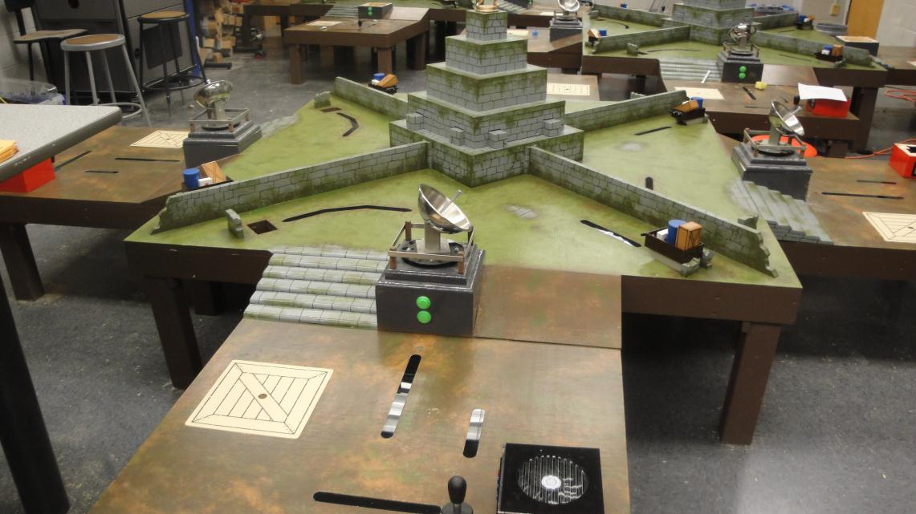
Moving forward: spring semester
Slightly different meeting schedule
Graphics & Design

Slide 32
What we changed
Reduced graphics workload
  Preparation
  Application
Continued preparation through design project

Slide 33
What we will change
Continue to shorten videos
  10-15 minutes
More closely relate quiz questions to the day’s topic
Optimize reading
Improve enforcement of preparation work

Slide 34
Questions?
Morin.29@osu.edu
Thanks to
  Krista Kecskemety
  Kathy Harper
  Paul Clingan
  The rest of the FEH staff

