Slide 1
Tools for the Flipped Classroom
Darwin R. Church
University of Cincinnati
Clermont College

Slide 2
What is a Flipped classroom?
Out-of class (before class):
watch a video, do a concept introduction, or a preparatory activity
In-class:
do active learning exercises, concept reinforcement, or application activity

Slide 3
Background
Jing – screen capture
Voice-over PPT
Wacom tablet
Smartpen
Smartboard
Screencast-O-Matic

Slide 4
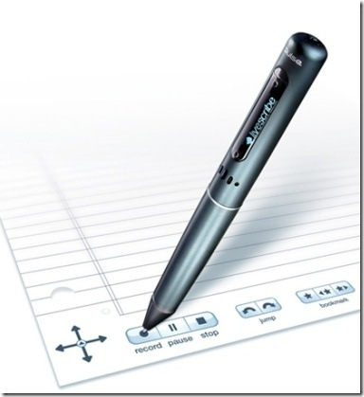
Tools for the Flipped Classroom
Screencast-O-Matic with Touchscreen Computer
Smartpen

Slide 5
Screencast-O-Matic
1. Screen capture recording software
Can record just the screen or the screen and a webcam
Can publish the video to YouTube HD or make an MP4 file.
4. Free version: 15 minute recording limit
5. $15/yr Pro version

Slide 6
Pros and Cons: Screencast-O-Matic
Pros:
It has audio and video.
With a touch screen computer, you can write on the PPT slide with a stylus. The video shows the writing as it is done, not all at once.
3. It is free.
Cons:
The videos sometimes stop playing.
The videos did not work with Internet Explorer.

Slide 7
Smartpen
It has a microphone and camera to record audio and video.
2. The pencast can be saved as a pdf.
3. The Echo pen costs about $120 at Livescribe.

Slide 8
Pros and Cons: Smartpen
Pros:
It has audio, video, and allows you to write.
It can be used as a recorder only.
Cons:
The pen screen lasts about three years.
2. Special paper is required.

