Slide 1
Sandra Doty
Ohio University Lancaster
SOS-AAPT Fall 2014
Problem Solving Strategies:
Thinking about effectiveness

Slide 2


Slide 3
Does an ability to do the steps of a problem solving strategy correlate with success in problem solving?
Almost every introductory physics textbook includes a problem solving strategy intended to guide the novice problem solver or, at least, get them started. Those strategies, more or less, all look the same. Speaking for myself, I know that I promote them as a way of helping the student organize the task before them and clarify their thinking. But do they work? Can we correlate the ability to perform the steps in a problem solving strategy with an ability to solve problems? In this talk, I will provide preliminary results from an investigation aimed at trying to answer this question.

Slide 4
Basic Problem Solving Strategy
Quick “some” read. Then a detailed read – underline important info.
Draw a picture.
  Identify important positions /times (initial, final)
  Coordinate system (+x, +y)
  x,y,v_{x},v_{y}, a, Forces, etc
Organize data – table / list knowns and unknowns
THINK
Substitute into appropriate equations (kinematics, Newton’s 2nd Law, Conservation of Energy, etc.)
Solve the math

Slide 5
What I Did, Why I Did it,
What I hoped
WHAT
Exam questions on components of ‘problem solving’ strategy
Compare exam grade w/o problem solving questions to problem solving pieces. Looking for correlations
WHY
Justify ‘teaching’ a strategy
Test whether the strategy helps
HOPES
Identify areas of weakness that can be remediated individually and for the class as a whole
Identify other “missing links” for the students
.

Slide 6
DRAW A PICTURE THAT ILLUSTRATES THE INFORMATION GIVEN IN THE PROBLEM BELOW. YOUR PICTURE SHOULD INCLUDE AN INDICATION OF THE COORDINATE SYSTEM YOU WOULD USE TO SOLVE THE PROBLEM AND THE DIRECTION OF THE ACCELERATION FOR THE PROBLEM.
A swing ride at a carnival consists of chairs that are swung in a (horizontal) circle by a 15 m cable attached to a vertical rotating pole. The cable makes a 60 degree angle with the vertical rotating pole.

Slide 7
DRAW A FREE BODY DIAGRAM FOR CART 2.
At an airport, luggage is unloaded from a plane into the three cars of a luggage carrier as shown in the drawing. The whole carrier accelerates to the right, as shown. The coefficient of kinetic friction between the cart and the ground is μ_{k}.

Slide 8
USING THE FREE BODY DIAGRAM, FIND THE EQUATIONS THAT DESCRIBE THE MOTION OF THE OBJECT IN THE X and Y DIRECTION. DO NOT SOLVE THEM.
N
a = 0
v = constant
T
Friction
30º
mg

Slide 9
SOLVE THE FOLLOWING EQUATIONS TO FIND THE FORCE, P.
P – mg sin35º – F = 0
N – mg cos35º = 0
F = μN
Where you will need to use:
            m = 96 kg
            g = 9.8 m/s²
            μ = 0.5

Slide 10
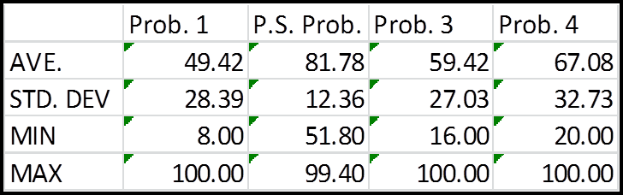

Slide 11
Thoughts:
Building a mental picture of what is happening in a problem is the most formidable problem our students face.
Once they have a picture, they can extract the relevant info.
Math is the least of their problems.

Slide 12
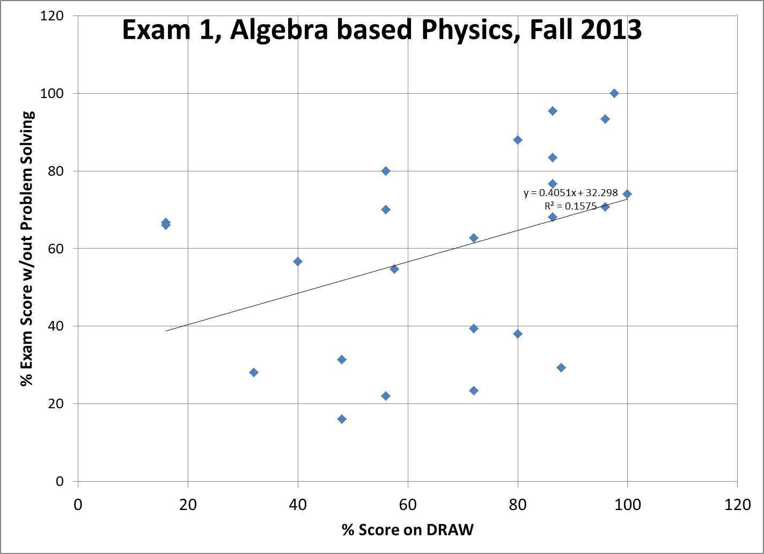

Slide 13
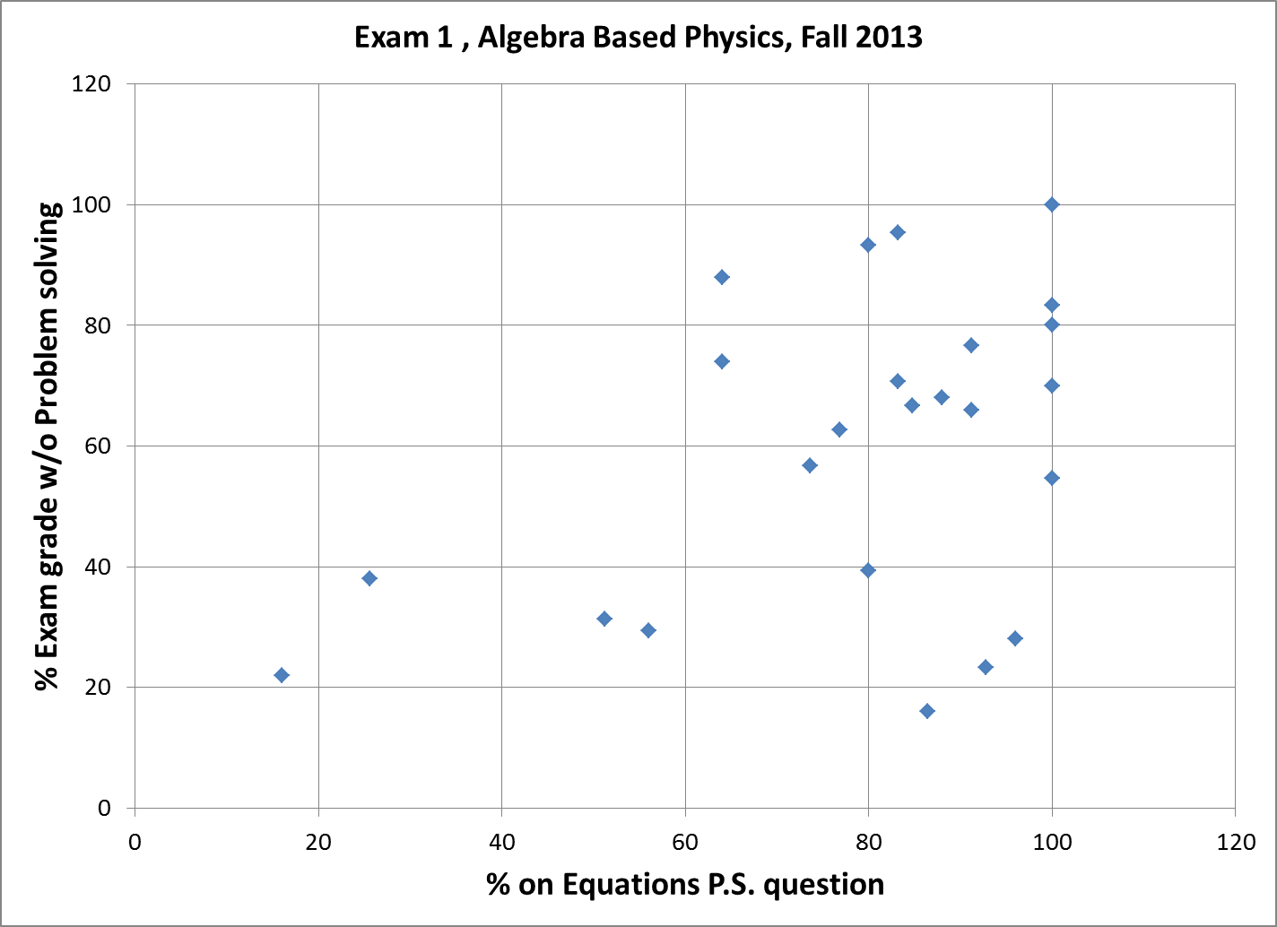

Slide 14
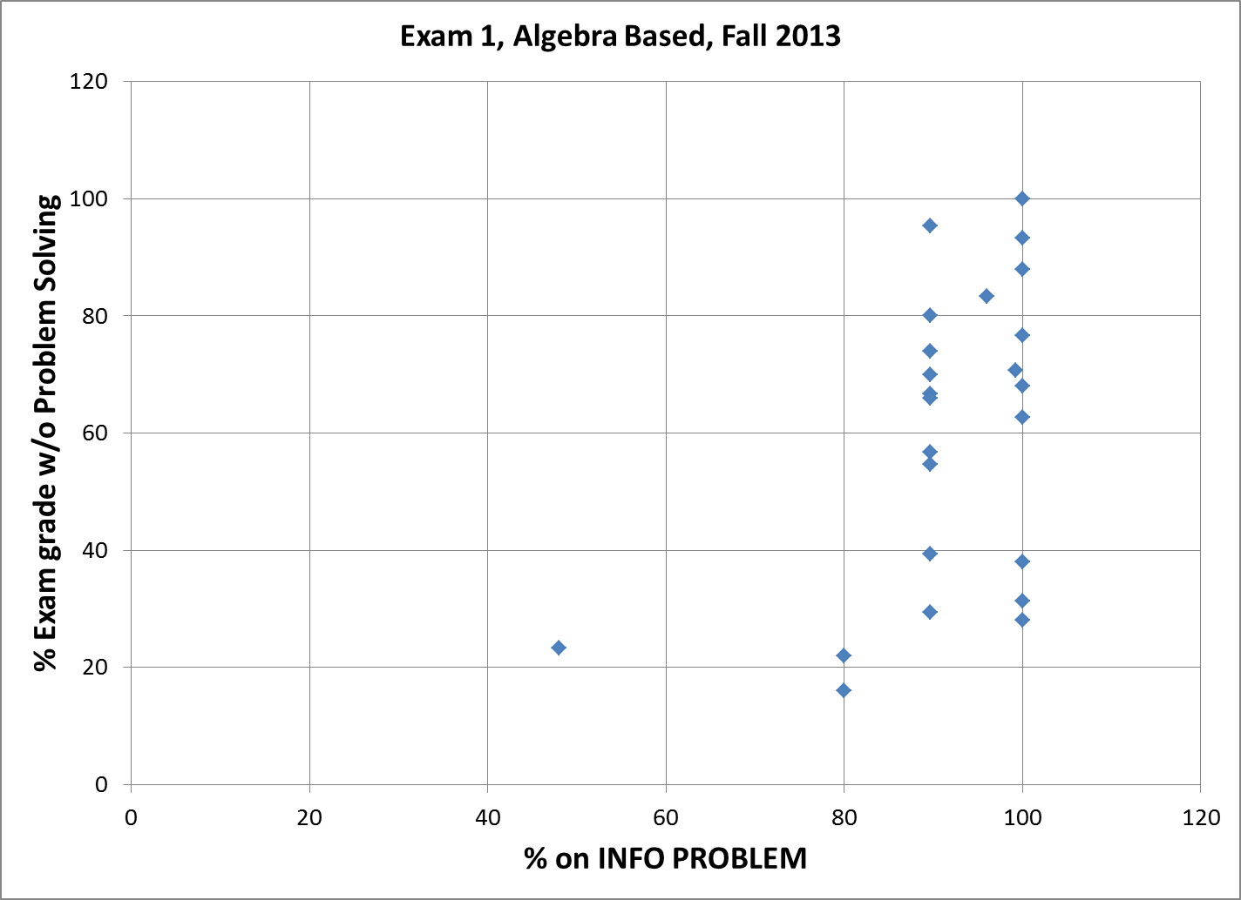

Slide 15
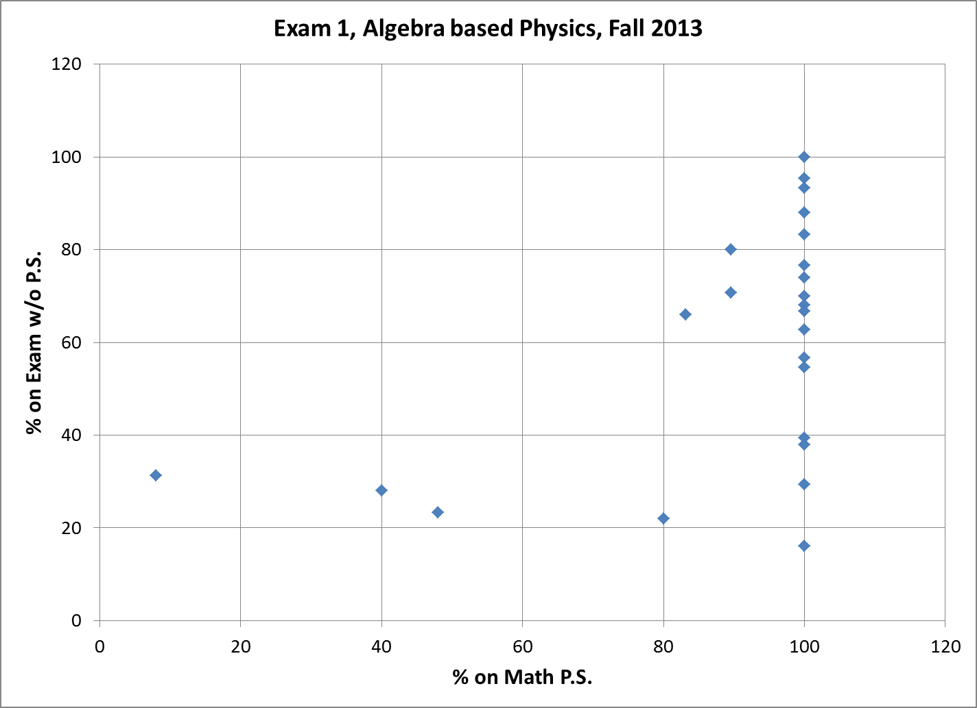

Slide 16
Continuing Work
  *Data collected on subsequent exams in Fall 2013 and into Fall 2014
  *Anecdotally noted improvement for individuals who targeted work based on P.S. outcome. Still analyzing data.
  *Low number statistics problem
  This year looking at ability to identify information in words.
  Working on extracting the information

Slide 18


